Slide 1

VSA Design
Team Kick-off and Alignment
Shawna Hein, Design Lead
shawna@adhocteam.us
September 4, 2019

Slide 2
Welcome!

Slide 3
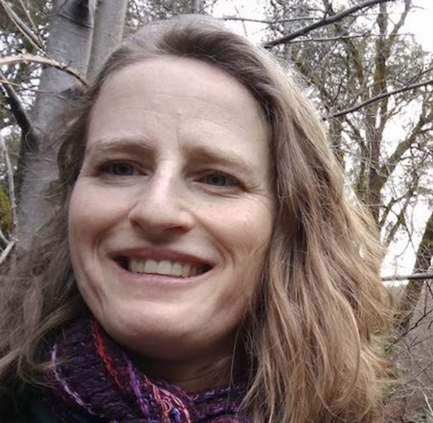

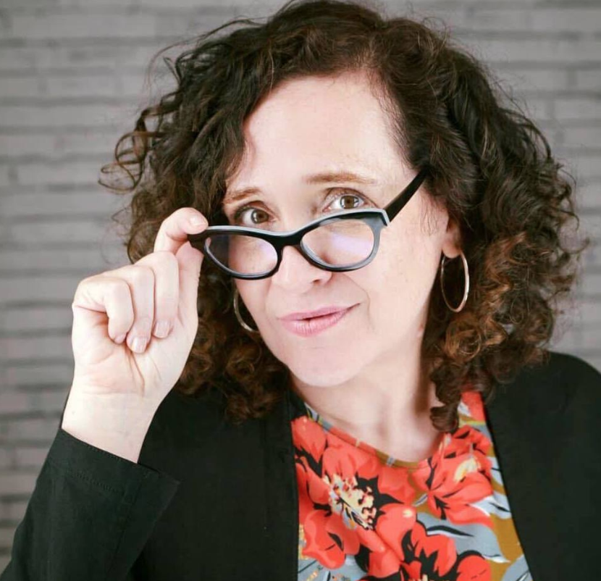

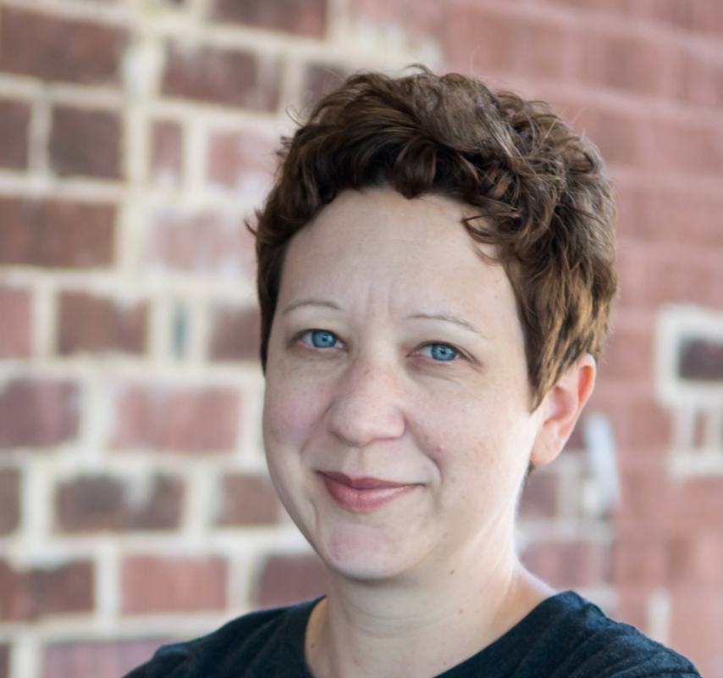
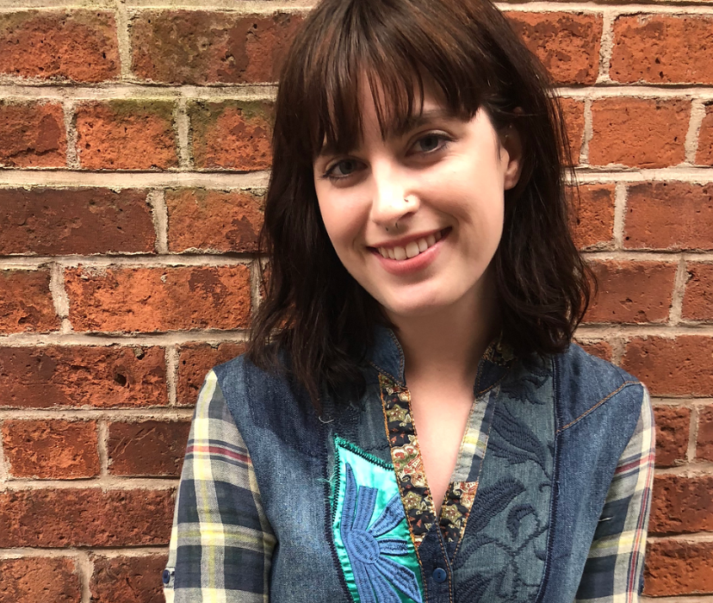


Introductions
WHO WE ARE
Where do you live?
How long have you been doing Design/UX work?
What part of research/design are you happiest doing (one thing)?
What’s something outside of work that takes up a lot of your time?
Shawna Hein
Design Lead
Aricka Lewis
Design/Research
Jennifer Strickland
Accessibility Design/Research
Jim Adams
Design/Research
Layla Soileau
Design/Research
Riley Orr
Design/Research
Arthur Green
Design/Research
Kevin Sachura
Design/Research
there will probably be 2 more of us soon… I don’t know how they will fit on this slide :)

Slide 4
The project

Slide 5
VA.gov’s mission
THE PROJECT
VA.gov enables veterans to discover, apply for, track, and manage the benefits they’ve earned.
VA.gov aims to be the new home for all veteran-facing, transactional services.

Slide 6
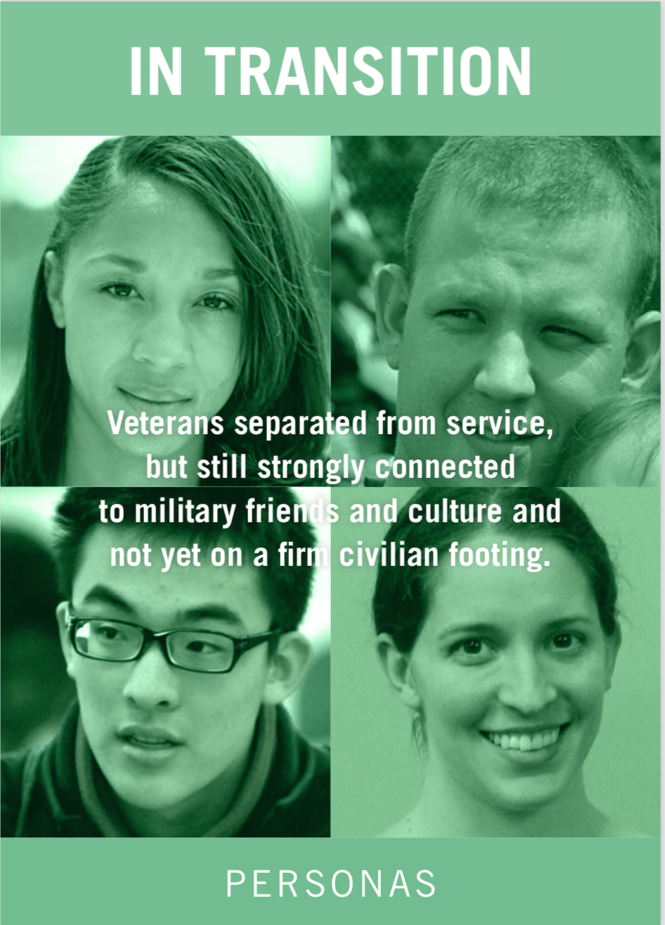



Who we’re serving (and when)
THE PROJECT
Read more here https://drive.google.com/drive/folders/1f5935fkqM4CeuQqzRk2ifi_ThKQSYFki

Slide 7
Who we work with

Slide 8
The landscape
WHO WE WORK WITH
DSVA
Digital Services @ the VA
VSA
VSP
lots of other contracts...
Veteran Services Applications
Veteran Services Platform

Slide 9
The teams

Slide 10
THE TEAMS
Team Structure
Veteran Services Applications (VSA)
Authenticated Experience
Global UX
Disability, Benefits, Appeals
eBenefits
Caregiver Discovery
Everything in the logged in experience on Va.gov
Responsible for the homepage, the crisis line banner, search, SEO, the and a lots of content pages
"Almost everything that's on (unauthenticated) va.gov that's an application"
Migrating content from ebenefits (an older service page) to VA.gov
2 sprint project to propose how we might modernize an application for a caregiver to apply for benefits

Slide 11
THE TEAMS
Team Structure
Veteran Services Applications (VSA)
Authenticated Experience
Global UX
Disability, Benefits, Appeals
eBenefits
Caregiver Discovery
Justin
Kara
Yana
Jason
Scott
DSVA: Lisa
DSVA: Chris, Jenn
DSVA: Andrea
DSVA: Steve
DSVA: David

Slide 12
THE TEAMS
Two more (most likely) soon...
Veteran Services Applications (VSA)
Facility Locator
Disability, Benefits, Appeals
2
Maybe even more I don’t know. There’s a lot of work to be done. :)
TBD
TBD
DSVA: Andy L.
DSVA: Matt S.
?
?

Slide 13
How we work

Slide 14
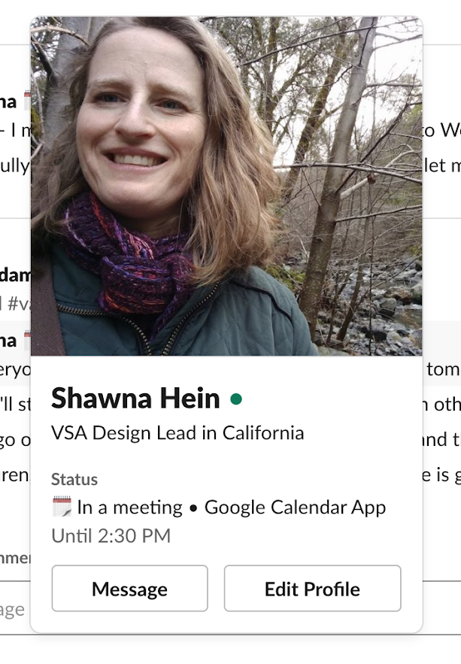
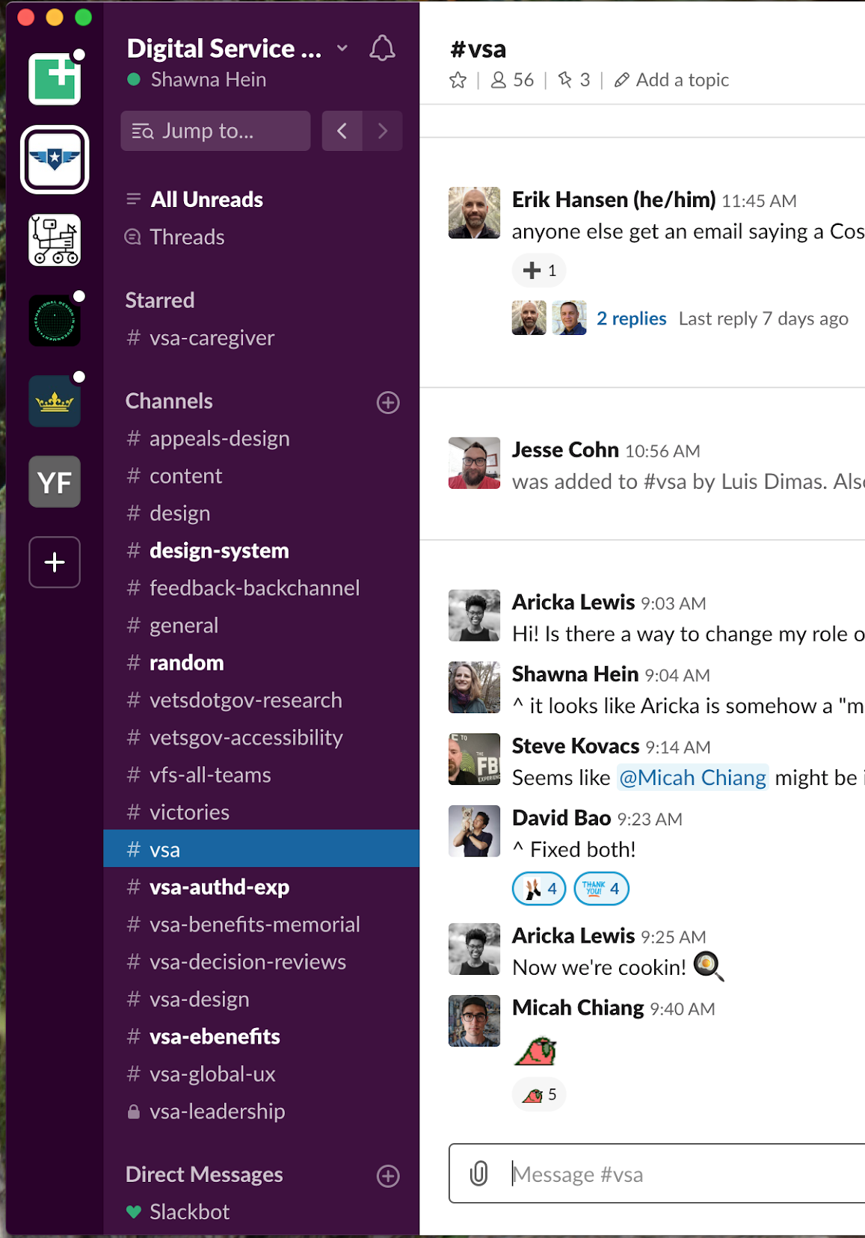
Slack
HOW WE WORK
We use Slack A LOT.
Please download the Slack app and check in on it regularly
Please contribute
For the most part use email sparingly
2 Slacks
DSVA
Ad Hoc / GCIO shared
Pictures / Profile
Privacy
Everything in the DSVA Slack is subject to the Freedom of Information Act (FOIA)
Starring / Jump to arrows
DMs versus channels

Slide 15
How we’ll collaborate
HOW WE WORK
Weekly design meeting
We’ll have a variety of topics here (e.g. session on accessibility, how we do research, etc.)
Informal sharing on #va-vsa-ux
It’s just us! it’s very safe!
Sharing on the DSVA #design channel
Useful if it’s a design that could benefit from context feedback
They’re nice I swear :)
Weekly Monday feedback session with all VA contracts
Books!

Slide 16
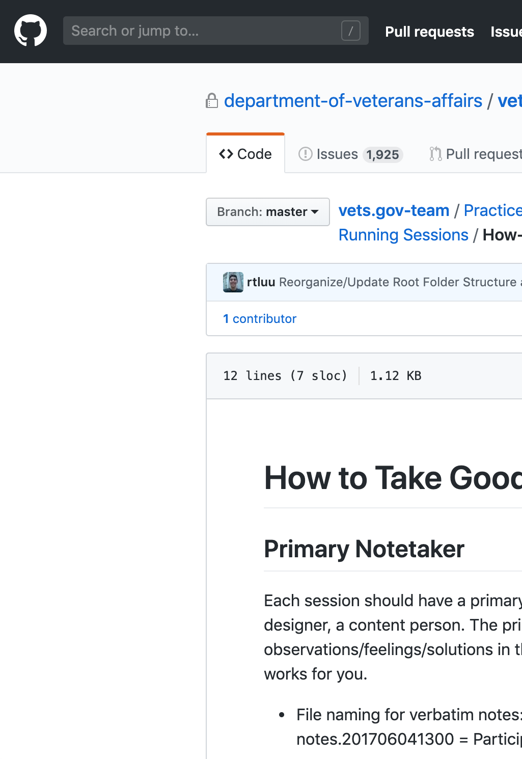
Github
HOW WE WORK
Most of your work (or requests to others for work) should be connected to a ZenHub issue or product folder
Decisions made in Slack conversations and meetings should be documented in GitHub
Planning, notes, documentation should be in a markdown (.md) file
Research documentation and design decisions should be stored in appropriate research folder within product folder
Cross-link any research to the research history

Slide 17
Software
HOW WE WORK
Sketch
InVision
Mural
Airtable?
Note: DSVA cannot view Google apps.
Another Note: I’m working on getting software for us, it’s been more difficult than I’d like but we’ll get there

Slide 18
Other things
HOW WE WORK
Try to have video on in all meetings (within reason)
Get added to the research calendar and sit in on user research if you can (even if not directly related to your team)
Refer to the Design section of our onboarding doc for more specific resources about running research and design on this project https://docs.google.com/document/d/1PE2HIw0WyAGrzeI_hKy5cwhllSPU-vygCn4JnkJDmgo/edit#heading=h.jhta5dxpodw4

Slide 19
Guest appearance

Slide 20
Questions?

